Slide 1
Name
Branch
email

Slide 2
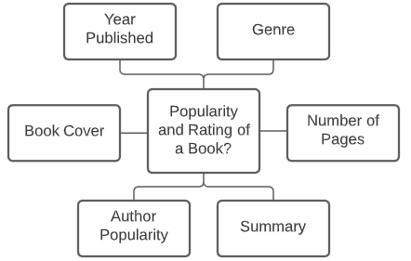
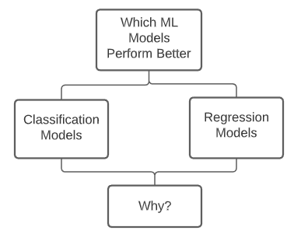
Motivation
In 2017, people in the U.S. 15 years and older spent an average of 16.8 minutes a day reading. This is down from 22.8 minutes in 2005.
We aim to identify which features contribute the most in deciding a book’s popularity.

Slide 3
Literature Review (1)
Analyzing Social Book Reading Behavior on Goodreads and how it predicts Amazon Best Sellers
This research takes into account reading behaviours along with other baseline features like rating, reviews etc to analyse if a book will become an Amazon Bestseller within a month of being published.
Uses Goodreads user status posts to create features like number of status updates, time taken to finish the book etc.
Classification problem
Obtained an accuracy of 88.72 % (Logistic Regression)

Slide 4
Literature Review (2)
Success in books: predicting book sales before publication
The research takes into account the features from the author(Popularity), book(Genre, publishing month) and publisher.
Popularity of the author is estimated by the number of views on the wikipedia page of the author and the sales of previous books as reported on the bookscan website.
Regression problem: predicted the sales of the book
Employed a new machine learning model: Learning to place which outperformed the other learning methods for this task.

Slide 5
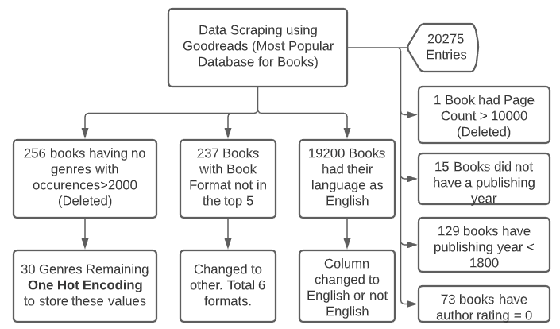
Data Scraping and Preprocessing

Slide 6
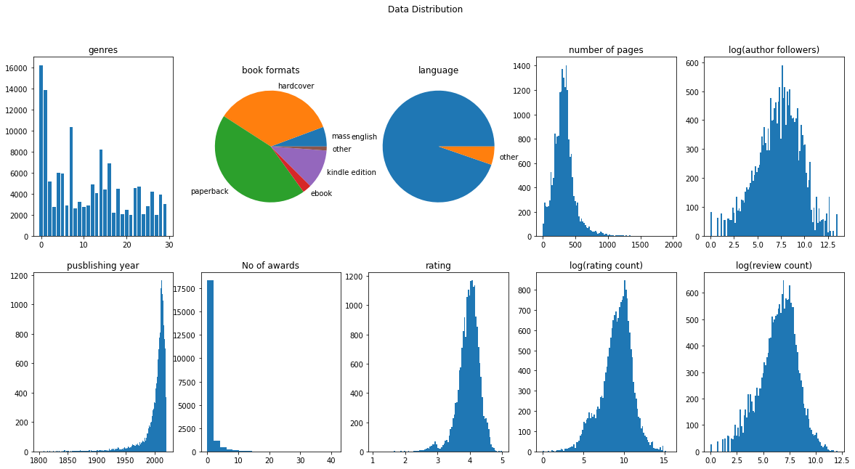
Exploratory Data Analysis
The ratings follow a gaussian distribution centered around 4.
Log(rating_count), log(review_count) and log(author_followers) is also gaussian

Slide 7
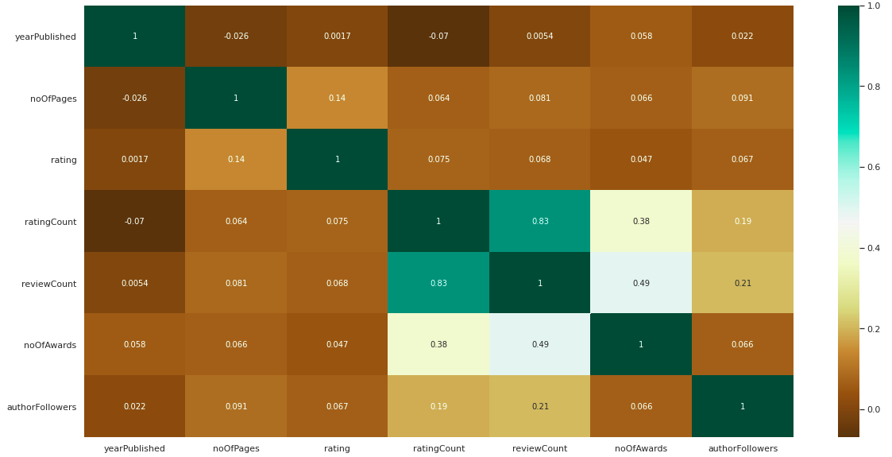
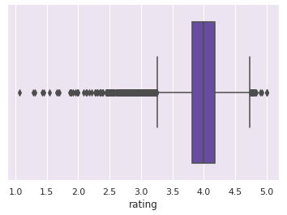
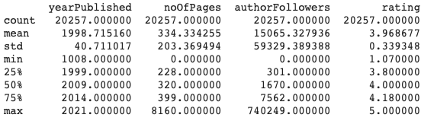

Slide 8
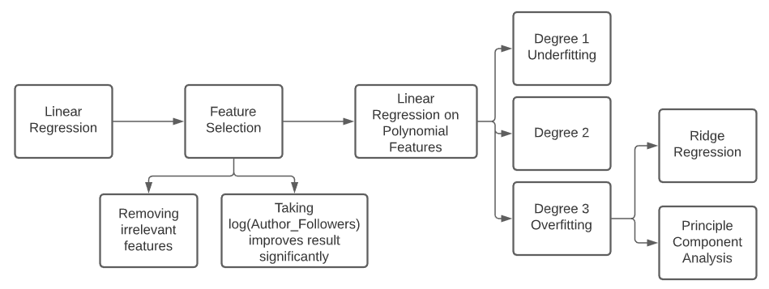
Methodology

Slide 9
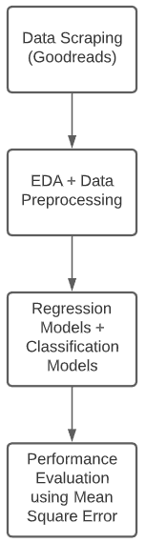
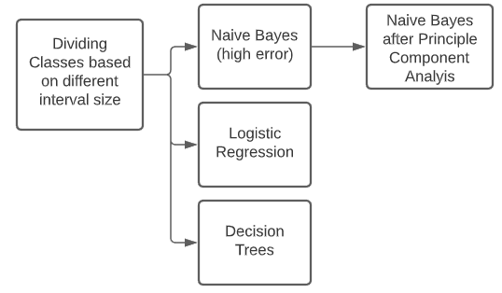
Methodology

Slide 10
Results
Feature Selection | Book format, review count, rating count, No. of awards were not taken, log(author followers) is a better feature than author followers.
Regression Model | Training MSE | Validation MSE | Inference
Linear regression (no of author followers) Linear regression (log(author followers)) | 0.205 0.095\ | 0.205 0.095 | Underfit
Linear regression degree 2 | 0.084 | 0.087 | Best fit, variance between training and validation is low
Linear regression degree 3 | 0.071 | 12.69 | Low training but very high variance in training and validation => Regularization required
Ridge regularization (degree 3) | 0.086 | 0.089 | Eliminated overfitting but still worse performance than degree 2 and increased computational overhead
Linear regression with PCA (degree 3) | 0.114 | 0.115 | Eliminated overfitting at variance threshold=.95 but still worse performance than degree 2. No benefit in using degree 3 polynomial features

Slide 11
Classification model | Class Interval Size | Training MSE | Validation MSE | Inferences
Naive Bayes Naive Bayes (With PCA) Logistic Regression Decision Tree | 0.5 | 1.83 0.18 0.43 0.22 | 1.84 0.18 0.43 0.22 | Features are not independent hence naive bayes performing very poorly. Naive Bayes sees a large improvement after PCA. Decision tree being a more complex model performed the best while other models were underfitting Performance improves with decrease in class interval size Class interval size 0.005 increases the classes too much with a lot of classes having frequency zero. Hence there is a decrease in performance.
Naive Bayes Naive Bayes (With PCA) Logistic Regression Decision Tree | 0.2 | 1.80 0.14 0.28 0.12 | 1.80 0.14 0.29 0.12
Naive Bayes Naive Bayes (With PCA) Logistic Regression Decision Tree | 0.1 | 1.59 0.14 0.28 0.11 | 1.59 0.14 0.28 0.11
Naive Bayes Naive Bayes (With PCA) Logistic Regression Decision Tree | 0.05 | 1.91 0.15 0.16 0.11 | 1.90 0.15 0.16 0.11
Naive Bayes Naive Bayes (With PCA) Logistic Regression Decision Tree | 0.005 | 1.32 0.18 0.26 0.11 | 1.33 0.19 0.26 0.11

Slide 12
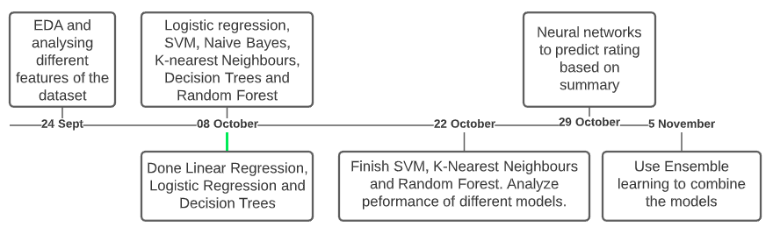
Timeline

Slide 13
Individual Contribution
Osheen: Feature selection on linear Regression and Naive Bayes
Vrinda: Ridge Regression, Lasso Regression and Logistic Regression
Ayush: Linear Regression on Polynomial Features and PCA
Everything else including Data Collection, EDA, Feature Selection etc. were done after discussions with everyone.

